Slide 1

TLA+ & TLA+ toolbox
Group 26:
Jiaxuan Zhang
Yiting Li
2020.1.14
QEES Tool Survey
Notes:
Hello. This is group 26. Our presentation is about TLA+ and TLA+ toolbox.

Slide 2
01
Introduction
02
Main Idea
CONTENTS
03
Language
04
TLA+ Toolbox
05
Demos
Notes:
we will first introduce the basic information of the TLA+ and TLA+ toolbox.
Next the core conceptions and important ideas about it.
Then the Grammar and the usage of TLA+ Toolbox.
Finally, there are two demos.

Slide 3
Introduction
Notes:
The first section is a basic introduction.

Slide 4
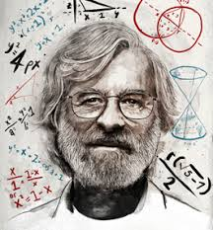

TLA+
A formal specification language developed by Leslie Lamport
Design, model, document and verify: software above the code hardware above the circuit level systems, especially distributed systems
Based on mathematics and does not resemble any programming language
Notes:
We have learned Petri-Net before. Petri net is one mathematical modeling languages to describe systems.
Similarly, TLA+ is a kind of formal specification language developed by Leslie Lamport, a famous computer scientist.
TLA+ is used to design, document, and verify software, hardware, and real-life systems, especially distributed systems and concurrent systems.
TLA+ is based on mathematics and does not resemble any programming language.

Slide 5
TLA+ Toolbox
The TLA Toolbox is an IDE (integrated development environment) for the TLA+ tools.
Create and edit your specs, with the locations of parsing errors marked in the modules.
View the pretty-printed versions of your modules.
Run the TLC model checker. The Toolbox allows you to explorer an error trace produced by TLC
Run the TLA+ proof system.
Users who would prefer a more lightweight IDE for TLA+ may want to try the Visual Studio Code extension for TLA+.
Notes:
Here comes the TLA+ toolbox. TLA+ toolbox is an IDE help us to parse or generate printed-vision model, and integrated TLC checker.
You can also use VS code extensions of TLA+

Slide 6
Main Idea
Notes:
In the second section, we will introduce core conceptions and important idea about TLA+

Slide 7
State Machine
TLA+ is state-based it models an execution of a system as a sequence of states behavior: a sequence of states step: a pair of consecutive states
TLA+ describes a set of behaviors with two things: An initial condition: specifies the possible starting states. A next-state relation: specifies the possible steps This kind of model is often called a state machine
TLA+ define the set of ordered pairs to model a system by describing the next-state relation
Notes:
First of all, TLA+ is state-based. When describing a system, it models an execution of a system as a sequence of states.
And in many related resources, a sequence of states is called behavior. A pair of consecutive states is defined as a step.
A TLA+ program tries to describe a set of behaviors with two things:
One is initial condition, specified the initial state of a system,
another is next-state relation, specified possible action from a state.
Almost the same as describing a state machine.
From my perspective, when trying to model a system with TLA+, we define the set of ordered pairs by describing the next-state relation。

Slide 8
Property Check
Invariant:
Invariant is a property of a mathematical object (or a class of mathematical objects)
it remains unchanged after operations or transformations of a certain type.
Temporal Formula:
temporal formula describe temporal logic
temporal logic is any system of rules and symbolism for representing, and reasoning about, propositions qualified in terms of time
Attention:
Most times, TLA+ cannot check the property “Theoretically”
It tries to find whether a property is satisfied in a practical-size state space by searching each state
Notes:
After modeling the system, we need to check the property of a system.
In TLA+, we have two kinds of properties: Invariant and Temporal Formula.
An invariant is a property of a mathematical object that remains unchanged after operations or transformation
Temporal Formula describes temporal logic; temporal logic means it’s Boolean value may change in time.
Pay attention, although TLA+ is based on mathematics. Most times, it cannot check the property “theoretically.”

Slide 9
Search Method
TLA+ tries to find whether a property is satisfied in a practical-size state space by searching each state
The searching method is Breadth First Search (BFS) by default
I
Notes:
That means TLA+ tries to find whether a property is satisfied in practical-size state space by searching each state.
By default, the searching method is BFS.
For example, in the state space shown,
it first checks the root
then the adjacent 3 states of level 2
and finally, the outer of level 3.

Slide 10
Grammar
Notes:
Here, we will show some basic grammar about TLA+.

Slide 11


Contents of Grammar
How to build model
An operator refer to a thing that does a thing, such as “==” or “=” or ”\in” etc.
Example:
Other operator:
If-else operator
Notes:
Firstly, operators.
An operator refer to a thing that does a thing, such as “==” or “=” or ”\in” etc.
* Operator’s example is here.
1. Double equal will assign a value to TypeOK.
2. Slash and backslash represent logical and.
3. Backslash in declares regions of variables. Here means variable small should be a value of 1 or 2 or 3
If and else are also operator:

Slide 12
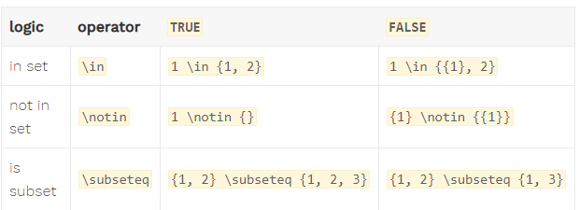
Contents of Grammar
Sets:
Sets is often used in TLA+, basic operation and serval transformation is introduced to TLA+.
Defining a set:
Set operation:
Notes:
Secondly, sets.
Sets is often used in TLA+
Here is how we define a set.
There are also some set operations, such as subset operation.

Slide 13




Contents of Grammar
Expression:
An expression is anything that follows an operator like ==, =, :=, or \in.
Constant expression:
Variables expression:
Action expression:
"EXECPT" detailed explanation:
https://www.youtube.com/watch?v=JwO4yPSEp-0&t=1034s
Notes:
Next, expression.
an expression is anything that follows an operator. you can see an example is in the black contour.
Here, the constant expression defines a set RM that keep constant
An action expression defines a next-state relation.
Here,
Prepare(rm) is an action.
The first raw in the right side can be regarded as a condition, means prepare action can happen if rm component of rmState equals string working.
The second raw describes a state transformation, the prime here is indicate next state of rmState. This raw means in next state, only rm component of rmstate will change.

Slide 14


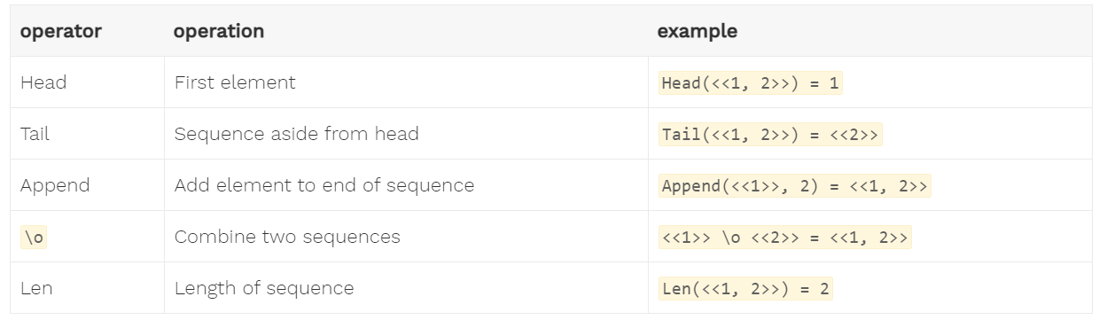
Contents of Grammar
Tuple:
Finite ordered list and is 1-indexed, specifying them with <<>>
Basic tuple operation:
Notes:
tuple is another important structure
A tuple is a finite ordered list (sequence) of elements and are 1-indexed.
TLA+ also provides some tuple operations here.

Slide 15


How to build a model
Function:
A function is a binary relation between two sets that associates every element of the first set to exactly one element of the second set.
Defining a function (two ways):
Example:
The state function describes binary relation between r and if-else expression
Notes:
The definition of function in TLA+ is quite mathematical.
A function is a binary relation between two sets that associates every element of the first set to exactly one element of the second set.
Here shows two way to define a function, we usually use the first one.
here is one example
The state function describes binary relation between r and the value of if-else expression.

Slide 16
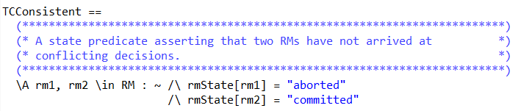
How to describe Property
Using formula to describe propety.
Example:
"aborted" and "committed" can't happen at the same time.
Other operator:
[]P, means that P is true for all states
<>P. means that for every possible behavior, at least one state has P as true
P ~> Q, implies that if P ever becomes true, at some point afterwards Q must be true
<>[]P, says that at some point P becomes true and then stays true
Notes:
After modeling, how to verify it? Here we use Formula:
We use formula to check the model behavior
Here is an example, TCconsistent means, string aborted and string committed cannot appear in the rmState simultaneously.

Slide 17
TLA+ Toolbox
Notes:
Here comes the TLA+ Toolbox part, in this part we will show the usage of TLA+ Toolbox with a simple demo.

Slide 18
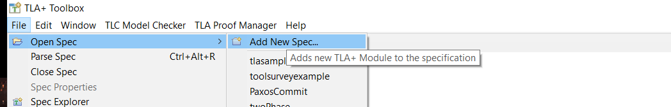
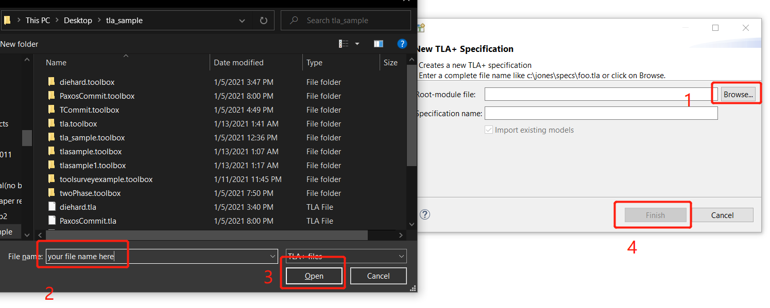
Download
Download the Toolbox
Toolbox link: https://lamport.azurewebsites.net/tla/toolbox.html
Download it and open the toolbox
Creating a new spec:
Select a file:
Notes:
You can download the Toolbox from this link, and after download it, open it,
following the step in the slide, name it and your workspace is ready.

Slide 19
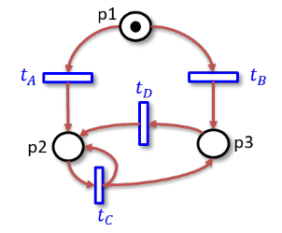
Demo 1
Considering a Petri-Net
Verification 2
Verification 3
Marking m = (0,1,10) can happen infinitely often
Notes:
Here is a Demo from Petri Net assignment;
we will use TLA+ to test whether it satisfies “for any reachable marking, token in p2 is less than or equal to the token in p3.”
and test whether marking m=(0,1,10) can happen infinitely often

Slide 20
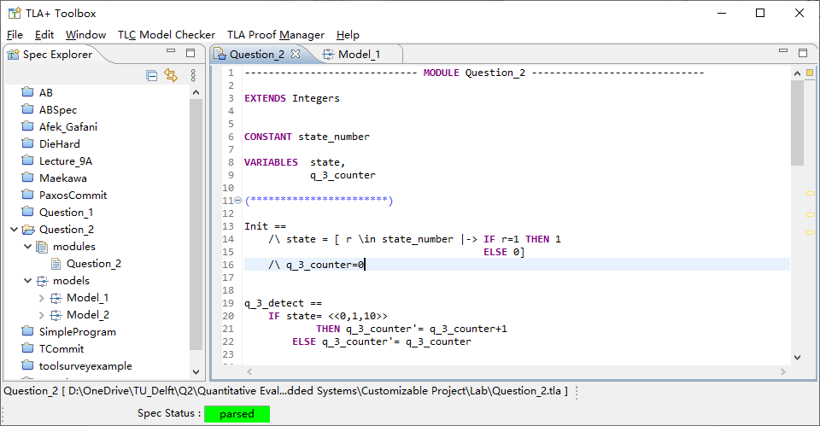
Build model
How to build model
Here to build our model
Notes:
In the TLA+ editor, you can build your model here
If model is parsed, a symbol will be shown in the bottom:
That means your model is correct.

Slide 21
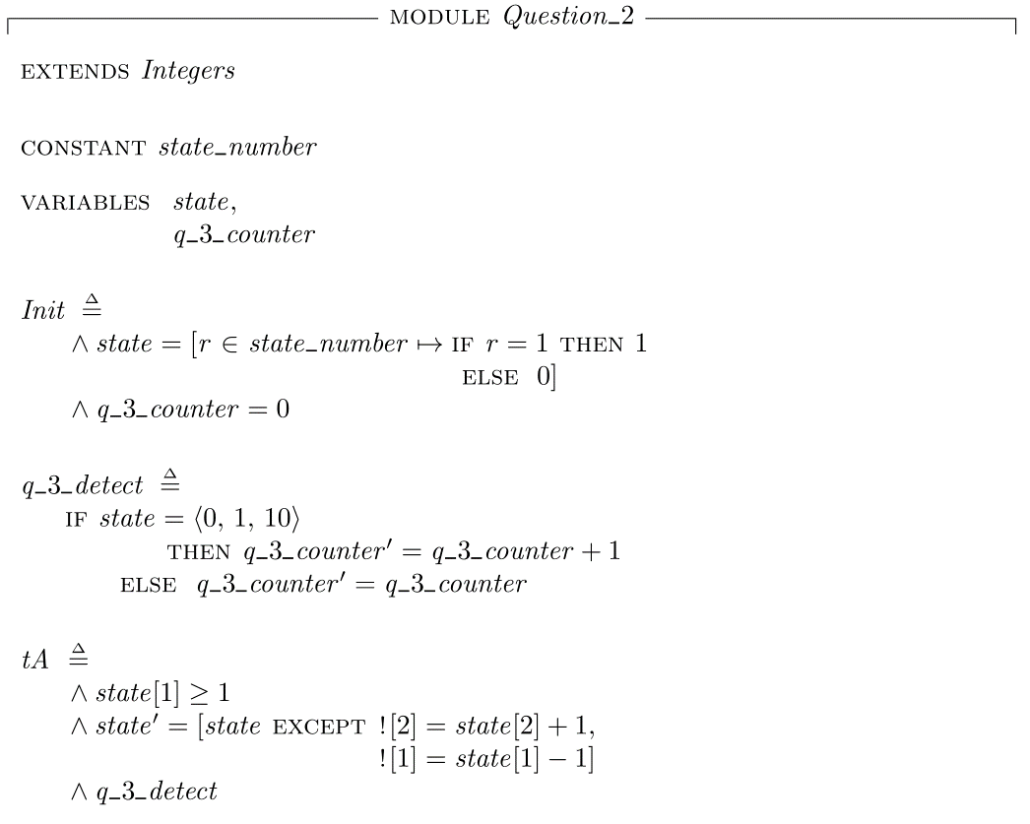
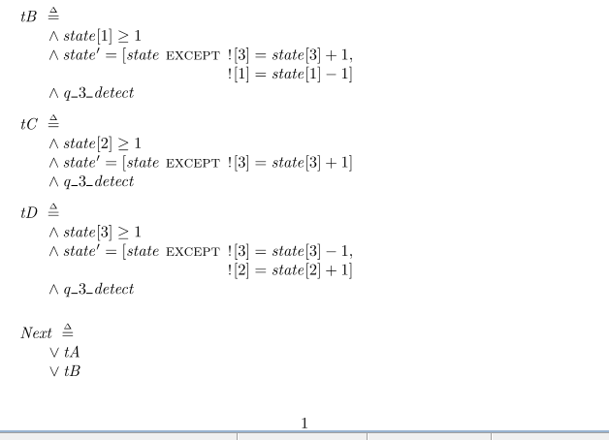
Model
Notes:
First, we model the petri net with TLA+
the Variable: state defines the places in the Petri net, and constant will be defined as the set of state index
Init defines the initial state, in which except place 1 has 1 token other place is empty.
Each operation is defined as below
for example, tB means,
when at the current state, if place 1, has more than 1 token,
then transition tB can be fired,
and in next state, place 3 add one token,
place 1 minus 1 token,
the total possible transition is defined as Next;
the expression means,
in a state, if the condition is met, tA or tB or tC or tD can happen

Slide 22

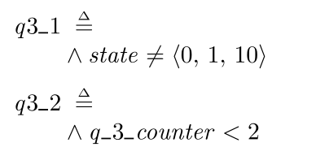
Describe the Property
Verification 3
First divide into two steps A: can initial state arrive to the first (0,1,10) ? B: can (0,1,10) arrive at (0,1,10) again ? Initial Proposition = A\/ B
Verification 2
Next describe the Property
Notes:
For verification 2, we first describe the property that is shown in the Left, we will regard it as an invariant property, means for any state, token in place 2 is no more than place 3.
For verification 3,
we first divide it into two steps:
A: can we arrive at (0,1,10) from initial state?
B: can we come back (0,1,10) from (0,1,10)?
if both A and B is true, then the original proposition is true
Next, we modeled it by these two formulae,
the first means we can never arrive at (0,1,10)
the second means, the counter of times arriving at (0,1,10) can never become 2

Slide 23
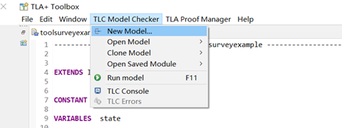
Set the TLC checker
Open a TLC model checker:
Name this model .e.g "model1"
Notes:
After building the model, you can click top bar of the window, and create a new checker model from here

Slide 24
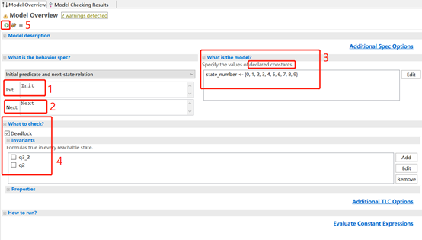
Set the TLC checker
TIC model checker window:
Following step 1-5 to run this model checker
Notes:
There are overall 1-5 steps to set and run this model checker

Slide 25
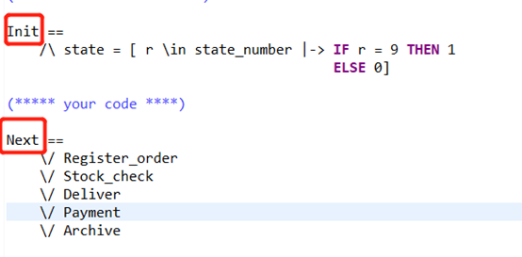
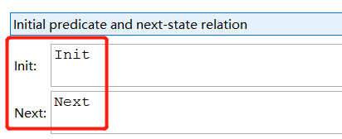
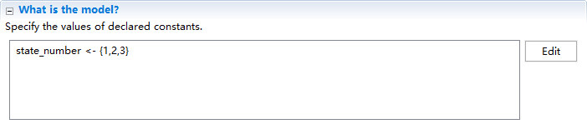
Set the TLC checker
How to describe property
Step1&2: specify initial state and next-state relation
Step3: constants specification
Notes:
Step 1 and 2 is to specify initial state and next-state relation
you need add your init state and next-state relation in this part
step 3 is to give value of the constants part in the specification
here we set the state number the set {1,2,3}

Slide 26
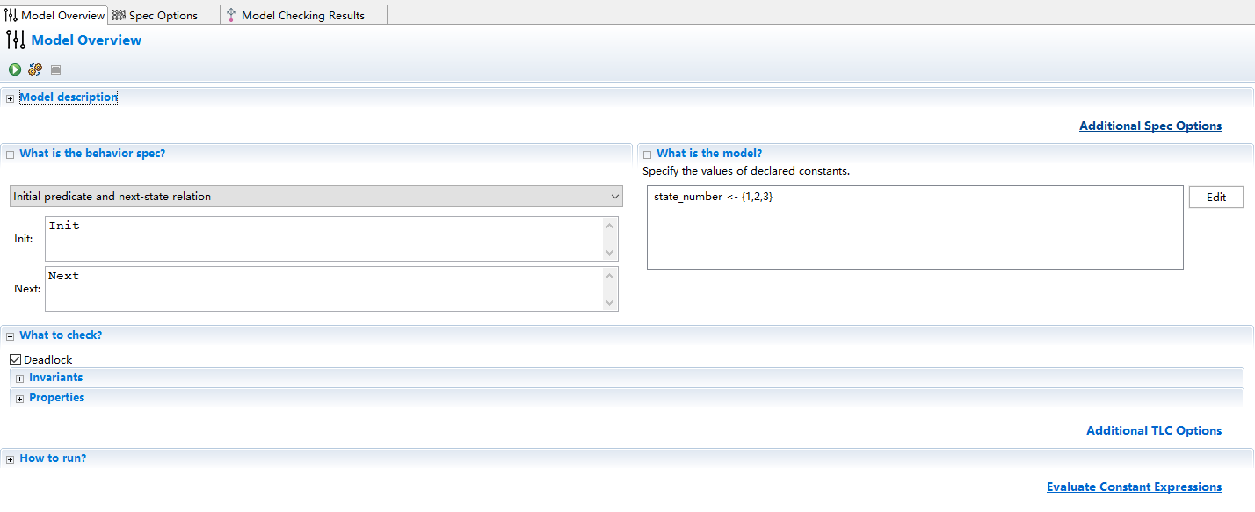
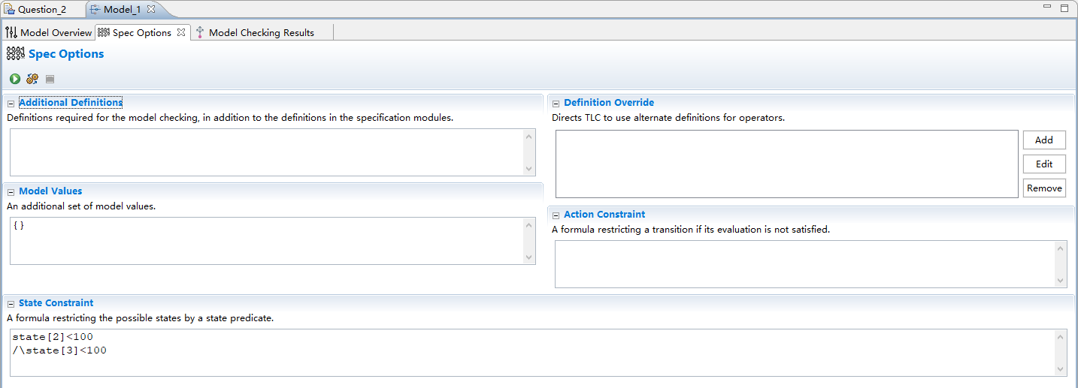
Set an upper-bound
Attention:
Most times, TLA+ cannot test the property “Theoretically”
It tries to find whether a property is satisfied in a practical-size state space
So we set an upper-bound
Notes:
But remember, we have mentioned that,
TLA+ is not able to test “theoretically.” , we need to smaller the state space to accelerate the search process
So for testing, we set the upper bound of states 2 and 3.

Slide 27
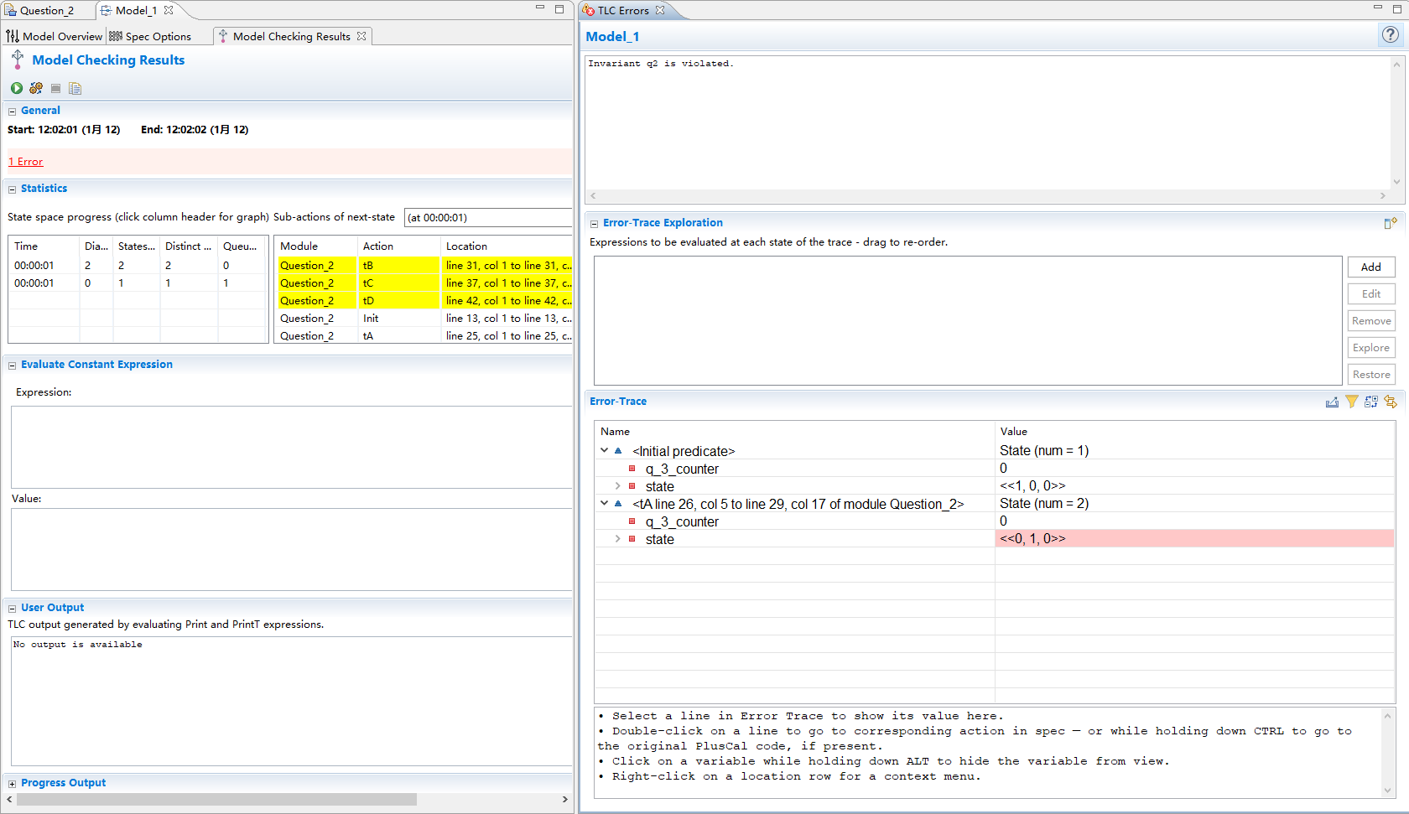
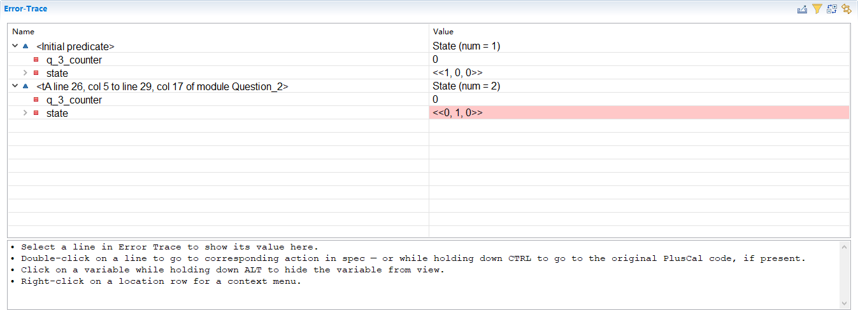
Use TLC checker to check the property
Result
Verification 2 proposition is not hold
Notes:
For verification 2, after pushing check button, the toolbox finds an error,
that is, the invariant is not hold, and it finds a trace.

Slide 28
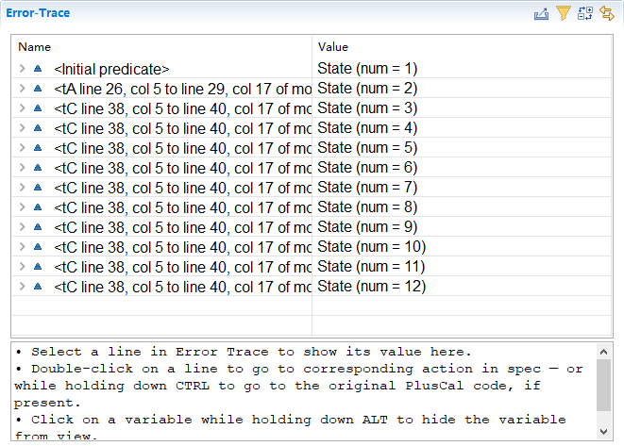
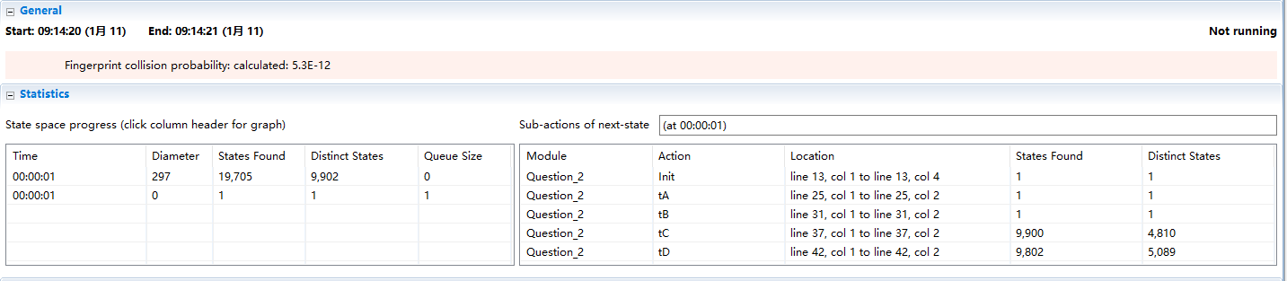
Use TLC checker to check the property
Result
First test q3_1, there is an error and TLA+ specified a trace to (0,1,10), that means A is true
Result
Then test q3_2, there is no error, that means B is error
Conclusion
Verification 3 proposition is not hold
TLA+ & TLA+ toolbox
28 / 33
Notes:
Then doing the same thing for verification 3
we tick on q3_1, the result is not hold
we tick on q3_2, the result holds.
So A hold while B not hold, so the original proposition is false、

Slide 29
Demos
Notes:
In this section, we will show another demo which also based on Petri Net Assignment

Slide 30
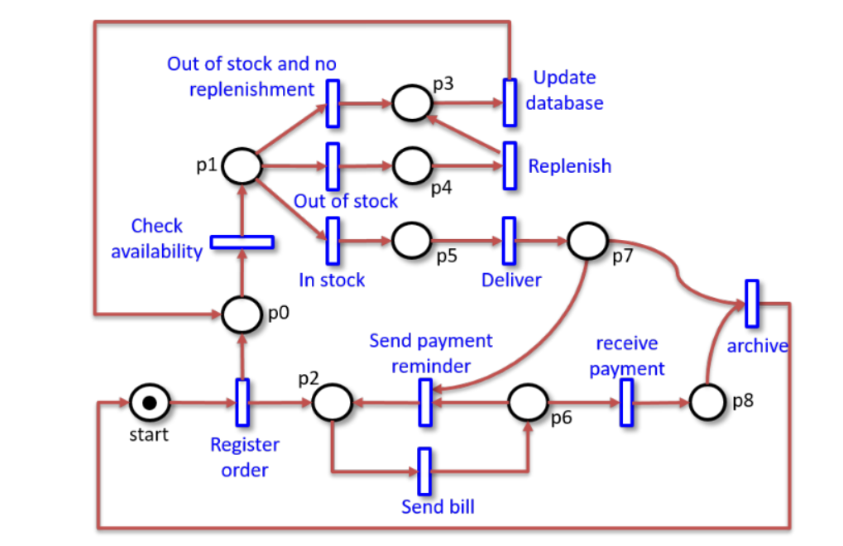
Demo 2
Considering another Petri-Net:
Verification 1: Whether there is a deadlock
Notes:
Here is the Demo 2, we check whether there is a deadlock

Slide 31
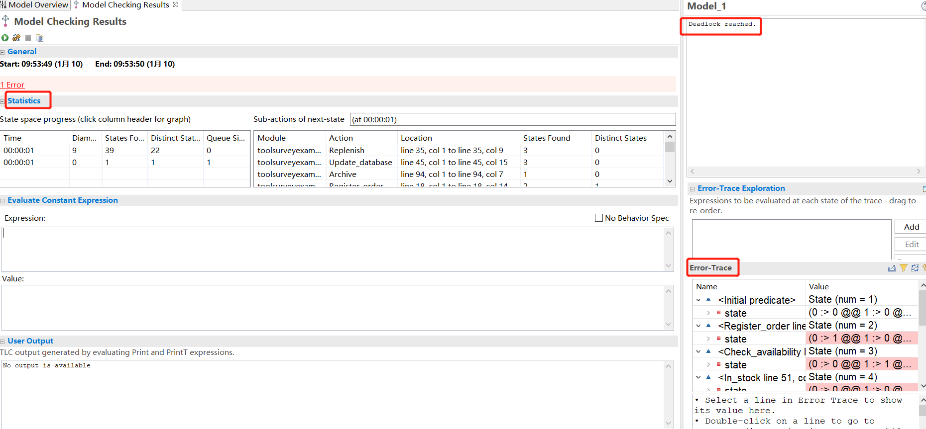
Result Page
Result Page
Outcome: statistics, trace, property
Notes:
The program is too long to show here,
after checking, we can find an error,
which means there is a deadlock,
and TLA+ gives the trace.
Here is the result page

Slide 32
Overview
Four subsections:
Introduction:
Formal specification language, Mathematical
Top-layer, Software, Hardware, Systems (especially DAs)
Basic Idea:
behavior → State Machine, Property → Searching (BFS);
Language & Usage:
How to build model
How to describe properties
How to use Toolbox
Demos:
Demo 1
Demo 2
Notes:
(There are also other more complicated application of TLA+, for example, we also finished a TLA+ model of Afek & Gafni election algorithm, and lamort himself verified his Paxos Algorithm with TLA+)
Here is an overview of today’s presentation.
First, we introduce the formal specifical language TLA+,
which is based on mathematical
and is a top-layer description of systems.
Second, we introduce the state machine, property check process,
Third, we introduce the language grammar and usage of the toolbox
Finally, two demos are given here to help us understand it.

Slide 33
More Resources and Suggestion
official website https://lamport.azurewebsites.net/tla/tla.html
Overview of Basic Grammar https://learntla.com/introduction/
Video Resources https://www.youtube.com/channel/UCajiu4Cj_GHOX0if3Up-eRA
Google Group
https://groups.google.com/forum/?fromgroups#!forum/tlaplus
Suggestion
It is really important to practice coding examples by yourself !
Notes:
Here are several extra resources,
the official website,
a third-party introduction,
official video resources,
and a Google discussion group.
The only important suggestion is,
DO practice using it by yourselves.
It is quite hard to learn it just by going through books or videos.

Slide 34
Thanks

